Slide 1
Chapter 7
Customer-Driven Marketing Strategy:
Creating Value for Target Customers

Slide 2
Customer-Driven Marketing Strategy:
Creating Value for Target Customers
Topic Outline
Market Segmentation
Market Targeting
Differentiation and Positioning
Helpful URLS
http://www.learnmarketing.net/
www.marketingteacher.com/

Slide 3
Procter & Gamble
One of Procter & Gamble’s fastest-growing brands, odor fighter Febreze, is now targeting a new lifestyle segment: college students. The brand recently kicked off “What Stinks,” an online and viral campaign for its fabric-refresher spray aimed at this sometimes hard to reach, fickle segment.
For most of the brand’s existence, it has been directed toward working adults and soccer moms, positioning itself as a “Breath of Fresh Air.” However, P&G realized that this targeting was leaving out an entire group of customers – Millennials, which includes college students.
Why is Febreze a natural for college students? “Washing is not a convenient part of the lifestyle at college,” says Martin Hertich, North American marketing direction for Febreze. In recent years, P&G has launched a movement to help students find ways to rewear unwashed clothes. For example, it recently introduced a new Swash line of dewrinkling sprays, stain-removing pens, and odor-removing sprays. Febreze is a natural extension.
A traditional, mainstream marketing approach would probably fail to reach this college student-segment. So, Febreze opted for an online and viral approach, built around an interactive website, www.WhatStinks.com, linked directly through Facebook.
The student-targeted Febreze What Stinks campaign, along with P&G’s other skillful targeting and positioning efforts for the brand, have helped make Febreze the world’s leading fabric freshener and deodorizer. It’s also one of P&G’s fastest growing brands.

Slide 4
Questions
Why did P&G decide to change the marketing of Febreze? After all, it was already a successful product within their company.
How does P&G promote the Febreze brand?
When P&G made the decision to reposition the product, why did it feel it had to market Febreze differently to reach this new target market?

Slide 5
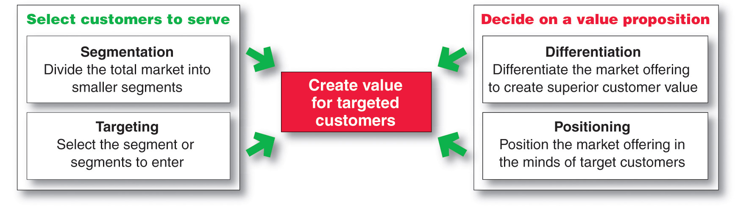
Customer Driven Marketing Strategy

Slide 6
Market Segmentation
Market segmentation is the process that companies use to divide large heterogeneous markets into small markets that can be reached more efficiently and effectively with products and services that match their unique needs

Slide 7
Market Segmentation
Segmenting consumer markets
Segmenting business markets
Segmenting international markets
Requirements for effective segmentation

Slide 8
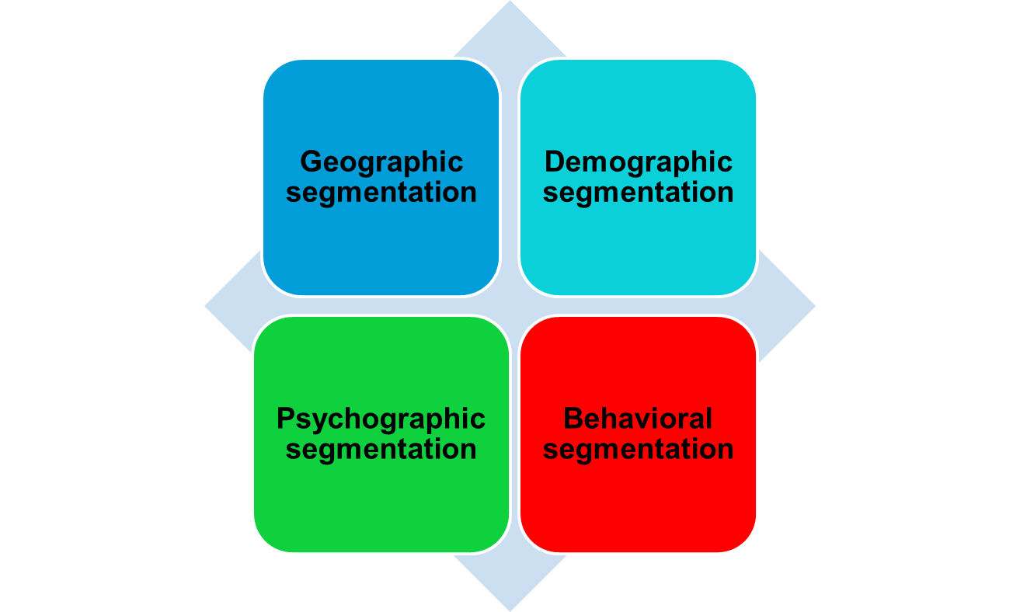
Market Segmentation
Segmenting Consumer Markets

Slide 9
Market Segmentation
Segmenting Consumer Markets
Geographic segmentation divides the market into different geographical units such as nations, regions, states, countries, or cities

Slide 10
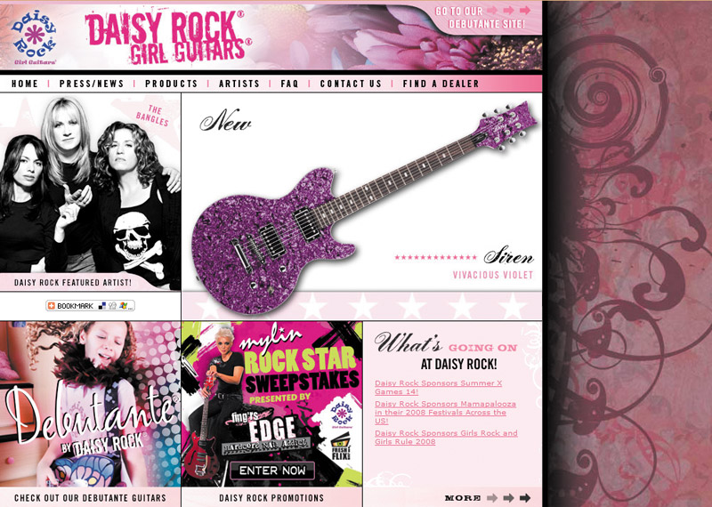
Market Segmentation
Segmenting Consumer Markets
Demographic segmentation divides the market into groups based on variables such as age, gender, family size, family life cycle, income, occupation, education, religion, race, generation, and nationality

Slide 11
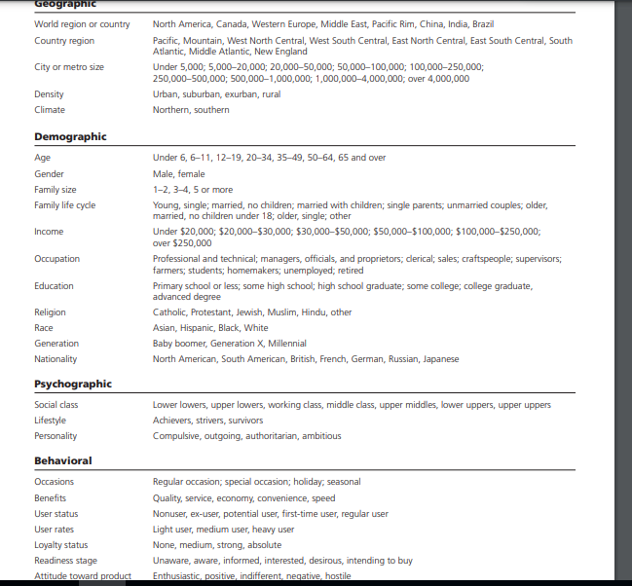

Slide 12

Market Segmentation
Age and life-cycle stage segmentation is the process of offering different products or using different marketing approaches for different age and life-cycle groups
https://www.youtube.com/watch?v=gf1SakItQXw
Gender segmentation divides the market based on gender (male or female)
https://www.youtube.com/watch?v=tXmWc9gDTqc

Slide 13
Market Segmentation
Segmenting Consumer Markets
Income segmentation divides the market into affluent or low-income consumers
https://www.youtube.com/watch?v=Z6FfNzVxisc

Slide 14
Market Segmentation
Segmenting Consumer Markets
Psychographic segmentation divides buyers into different groups based on social class, lifestyle, or personality traits
https://www.youtube.com/watch?v=eu-1ULsrUXs

Slide 15
Market Segmentation
Segmenting Consumer Markets
Behavioral segmentation divides buyers into groups based on their knowledge, attitudes, uses, or responses to a product
Occasions
Benefits sought
User status
Usage rate
Loyalty status

Slide 16
Activity
https://www.youtube.com/watch?v=_bjlR5HHqdM
https://www.youtube.com/watch?v=ZEWGQFEeKq8
https://www.youtube.com/watch?v=t7j3sBZJFDo

Slide 17
Market Segmentation
Using Multiple Segmentation Bases
Multiple segmentation is used to identify smaller, better-defined target groups
Geodemographic segmentation is an example of multivariable segmentation that divides groups into consumer lifestyle patterns

Slide 18
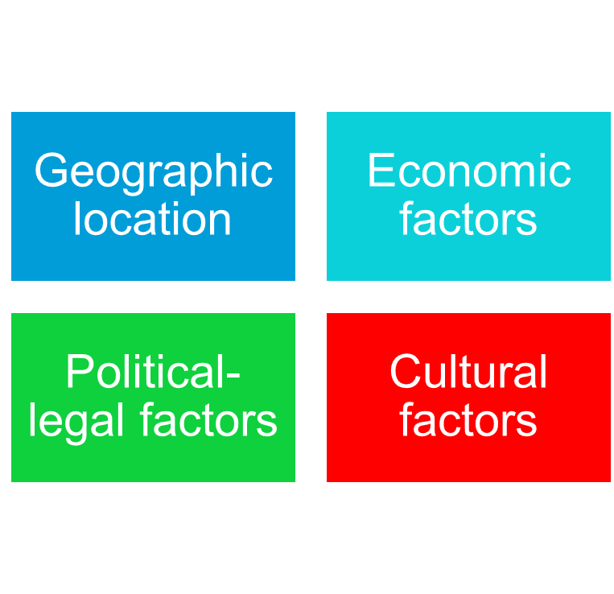
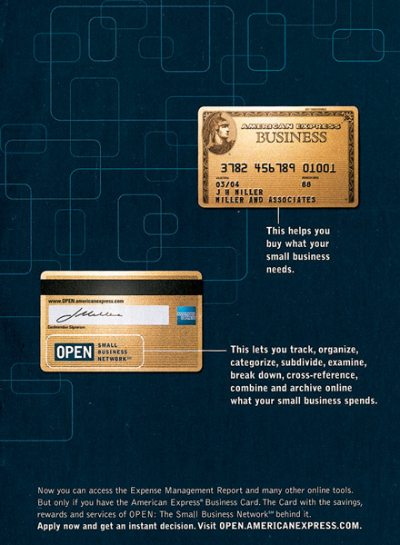
Market Segmentation
Segmenting International markets

Slide 19
Market Segmentation
Segmenting Business Markets
Intermarket segmentation divides consumers into groups with similar needs and buying behaviors even though they are located in different countries

Slide 20
Requirements for Effective Segmentation
Measurable: The size, purchasing power, and profiles of the segments can be measured. For example smart phone sales are growing rapidly but which segments of the market are they growing in? and in which segments is growth stagnant?
Accessible: The market segments can be effectively reached and served.
Substantial: The market segments are large or profitable enough to serve.
Differentiable: The segments are conceptually distinguishable and respond differently to different marketing mix elements and programs. If men and women respond similarly to marketing efforts for soft drinks, they do not constitute separate segments.
Actionable: Effective programs can be designed for attracting and serving the segments. For example a small business with a £45000 turnover would not accept a multi million pound manufacturing contract.

Slide 21
Market Targeting
Selecting Target Market Segments
Target market consists of a set of buyers who share common needs or characteristics that the company decides to serve

Slide 22
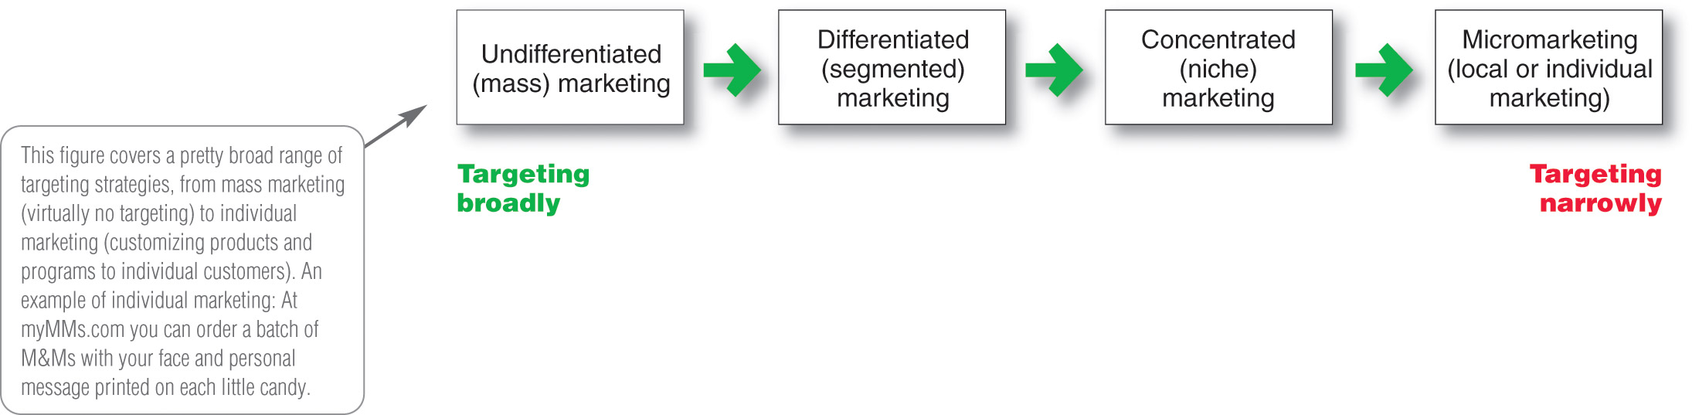
Market Targeting
Target Marketing Strategies

Slide 23
Market Targeting
Target Marketing Strategies
Undifferentiated marketing targets the whole market with one offer
  Mass marketing
  Focuses on common needs rather than what’s different
https://www.youtube.com/watch?v=VGa1imApfdg

Slide 24
Market Targeting
Target Marketing Strategies
Differentiated marketing targets several different market segments and designs separate offers for each
Goal is to achieve higher sales and stronger position
More expensive than undifferentiated marketing

Slide 25

Marketing Targeting
Target Market Strategies
Micromarketing is the practice of tailoring products and marketing programs to suit the tastes of specific individuals and locations
Local marketing
Individual marketing

Slide 26
Market Targeting
Target Market Strategies
Local marketing involves tailoring brands and promotion to the needs and wants of local customer groups including:
Cities
Neighborhoods
Stores
Notes:
Local marketing is a marketing strategy that targets consumers and customers within a certain radius of the physical location(s) of a business. Local marketing is also known as neighborhood marketing or local store marketing.
Penne Lane, Pane & Amore, Local gyms, Tailors

Slide 27
Market Targeting
Target Market Strategies
Individual marketing involves tailoring products and marketing programs to the needs and preferences of individual customers.
Personalization
Customization
Relationship Building
Loyalty Programs

Slide 28
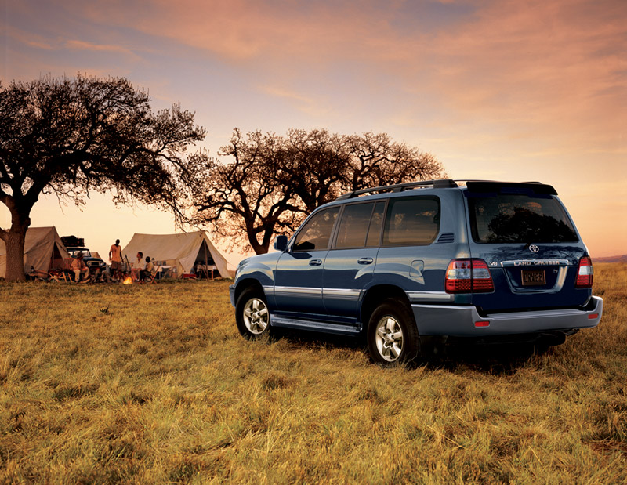
Differentiation and Positioning
Product position is the way the product is defined by consumers on important attributes—the place the product occupies in consumers’ minds relative to competing products

Slide 29
Differentiation and Positioning
Identifying Possible Value Differences and Competitive Advantages
Competitive advantage is an advantage over competitors gained by offering consumers greater value, either through lower prices or by providing more benefits that justify higher prices.
https://www.youtube.com/watch?v=oyJvd876UIc

Slide 30
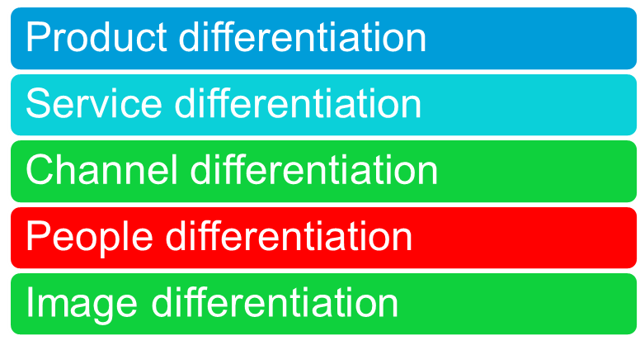
Differentiation and Positioning
Choosing a Differentiation and Positioning Strategy
Identifying a set of possible competitive advantages to build a position by providing superior value from:

Slide 31
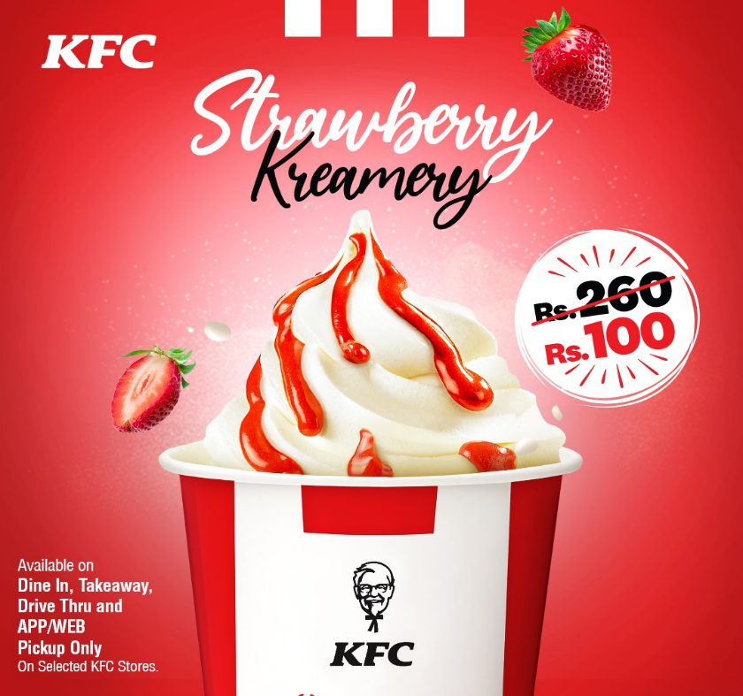
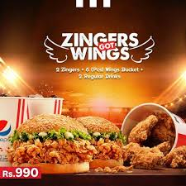
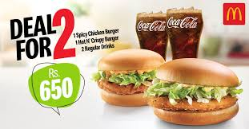

Slide 32
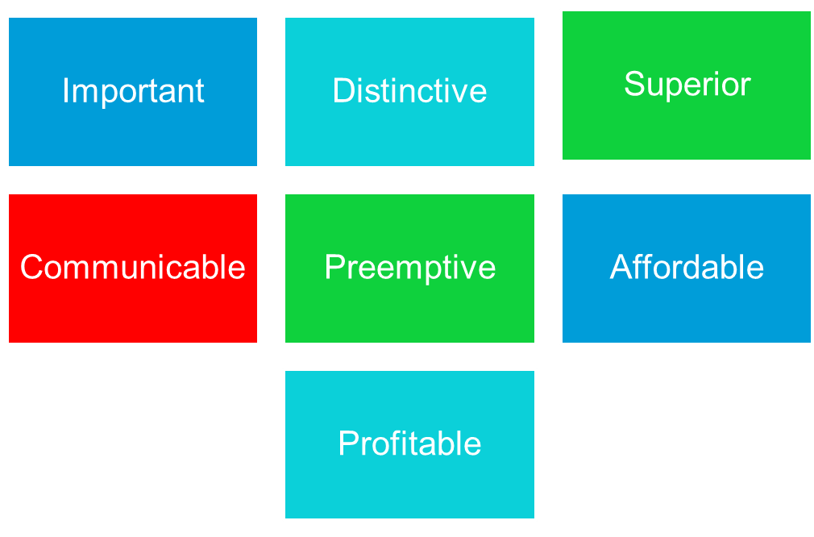
Differentiation and Positioning
Choosing the Right Competitive Advantage
https://www.youtube.com/watch?v=beB249dZFlQ
https://www.youtube.com/watch?v=2B_hX5g539I

Slide 33
Choosing the right Competitive Advantage
More for the same
The same for less
Less for much less
More for less

Slide 34
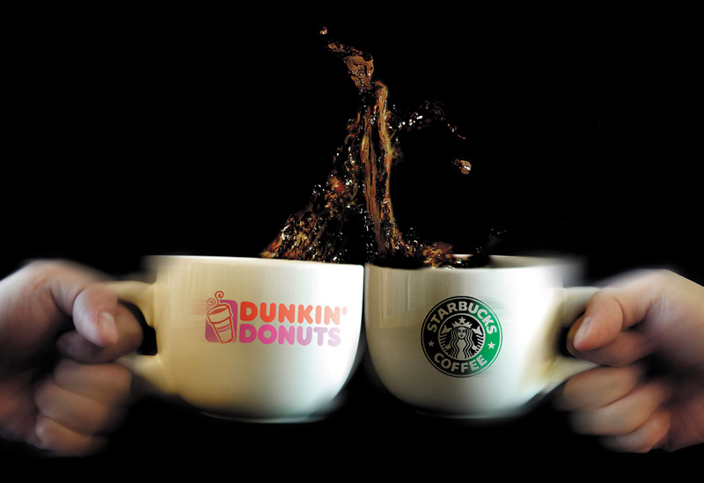
Communication and Delivering the Chosen Position
Choosing the positioning is often easier than implementing the position.

